Slide 1
Classical Planning
Non-Forward Search
Introduction to HTN Planning
6CCS3AIP – Artificial Intelligence Planning
Dr Tommy Thompson
Notes:
Hello and welcome to this chapter of Classical Planning as we continue our exploration of non-forward search techniques. In this chapter we’re going to take a look at a rather different approach known as Hierarchical Task Network or HTN planning.

Slide 2
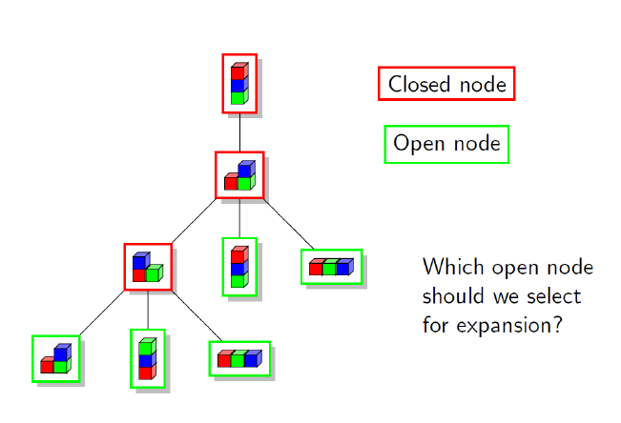
Recap: Non-Forward Search
Exploring planning techniques that deviate from the traditional forward-search approach.
Initial state, open list, closed list, heuristic etc.
Graphplan:
Generate plan graphs forward, then search backward.
SAT Planning
Planning as satisfiability
POP Planning
Partial orders on plan execution.
Notes:
To quicky recap, this segment of the module is built around the idea that our traditional method of moving through the search space as we’ve discussed throughout the classical planning phase of the module isn’t the only way in which we can think about planning.
We’ve taken a look at some slightly different approaches and how they try to resolve planning in their own ways, with the likes of Graphplan and PoP planning being something new and unique from what we’ve seen to-date.
In this chapter, we’re going to continue this trend, by introducing a different perspective on how to solve a planning problem, that leans much more heavily on some of the ideas of how we as humans try to solve problems.

Slide 3
Hierarchical Task Network (HTN) Planning
In real life, we seldom plan down to the minutiae of detail, we instead think more abstractly.
E.g. “getting out of the house in the morning”:
waking up, washed, dressed, breakfast etc.
In many planning problems, we – as the designer – may already have ideas about what good solutions might look like.
E.g. driving to packages to pick them up, driving to destinations to drop them off.
Basic Idea: What if we put this information directly into the domain?
Notes:
If you recall the chapter a while back on SAS+ planning, the core premise is that we are exploiting a key facet of human understanding in the planning approach, that we can quickly make intelligent assumptions about how facts can invariants of one another and that was something we had to work hard to encode in a planner.
This time around, we’re thinking about another facet of human behaviour, and that’s about abstraction and decomposition of a task we give ourselves.
As humans we plan all of the time, we try to figure our way through a given day, identifying tasks we’re going to complete and in what order. But often, we don’t really worry about the minutiae of the execution until we start to actually do it.
So say for example, you need to get out the house in the morning: you have a job or you’re going to school or university and you know you have to get to your destination. Now we typically think of it as, getting up and getting out of the house in the morning. But you usually have a routine for doing that. In my case, I would…
Wake up and get out of my bed.
Then head to the bathroom, grab a shower, brush my teeth, and grooming such as fixing my hair or shaving that I need to do. I may also need to go to the toilet.
I’d head back to my bedroom to get dressed.
Then head to the kitchen and grab some breakfast: that could be some cereal, porridge, toast, a croissant and maybe fruit juice, tea or coffee.
Then put on my shoes, grab my bike and head out.
Now two things to address here:
First, how I handle my morning routine could be different from you. You might have the same actions in a different order, or you may omit some of these (hopefully you remember to get dressed though).
Secondly, as I described it, it became much more grounded and complex than the original description I wrote in the slide of wake up, wash, dress, breakfast.
So here when I complete this larger task of getting out the house, I already have a routine or pre-determined notion of how this should be done. So, can we embed that knowledge into a planning domain when we try to solve it?

Slide 4
Hierarchical Task Network (HTN) Planning
Reframe the planning problem:
Tasks to complete instead of goals to satisfy.
Tasks are little more abstract than a typical planning problem.
Methods to decompose tasks into subtasks.
Enables for gradual decompositions of complex task into smaller and more manageable tasks.
A subtask could be a single action, or another method in and of itself.
We enforce constraints of the problem in the method and actions.
Simplest version: Simple Task Network (STN) Planning
Notes:
So in HTN planning our aim is to reformulate a typical planning problem into a different format.
Instead of goals we seek to achieve, we have tasks we wish to complete and this is a much more high-level concept than our original goals. It might be more common to say travel from my house to the university as a task in HTN planning than to say (at university = true) for example.
In addition, we then use methods to express how a given task could be solved. These methods then decompose the original task into subtasks, which in turn can be solved either by transforming that task into a single concrete action, or the task is handled by another method, which further decomposes said task into more tasks.
We then can apply much broader sets of constraints on action execution. So for example, we not only have the actions that we can reduce a task to have the traditional preconditions and effects we’re used to seeing, the methods also have preconditions attached to them that dictate whether they are applicable.
In this chapter my focus is largely just to explain how HTN planning works as a concept rather than specific implementations of the planning process, but we can also talk about that briefly. In addition, in the material this actually covering a special case of HTN planning known as simple task network planning or STN planning. Given this is arguably the more commonly discussed and implemented version of the process.

Slide 5
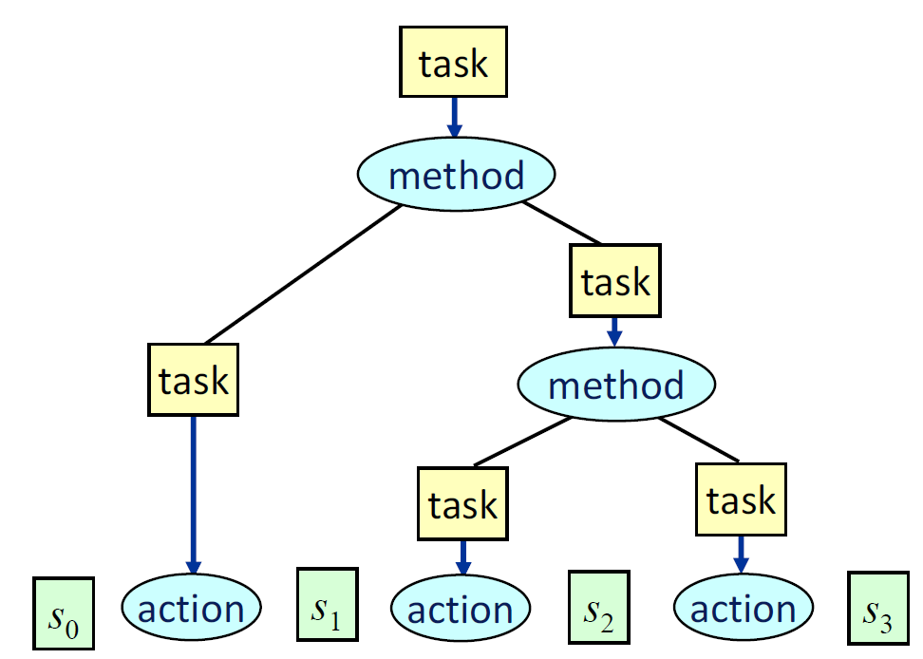

HTN Planning: More Formally…
HTN Planning Problem: $(∑, M,A, s0, T)$
$∑$ - a state-variable planning domain.
$M$ - a set of methods
$s0$ - the initial state of the problem
$T$ - a list of tasks to complete
Σ = (S,A,γ)
s ∈ S, a ∈ A
γ(s,a) → s’
Image Credit: Lecture Slides for Automated Planning and Acting
Nau, D. 2016
Notes:
If we were to consider this more formally, then we would consider the HTN planning problem as 4-tuple, $∑$, M, s₀ and T.
$∑$ is our traditional state variable planning domain, like we have seen previously. This includes the set of all states, S, the set of all actions A and our state-transition function γ.. This will allow us to be in a given state, apply an action to the state using γ and discover what resulting state s’ emerges from that interaction.
Next up we have M, this is a set of methods that are designed to decompose tasks. As we’ll see in a minute, the types of tasks we are dealing with can either be reduced to a single action in $∑$ that we can then execute, or it will translate that task into another type of task that could potentially be resolved by another method.
We have the initial state of the problem s₀, much like we’ve seen before.
Lastly, we have the tasks we want to complete, this could be just one task which requires us to decompose it, or numerous tasks with some ordering to them that we wish to consider.

Slide 6
Hierarchical Task Network (HTN) Planning
HTN planning defines two types of tasks.
Primitive Tasks: Translate to single planning action.
Compound Tasks: Translate into a collection of one or more tasks.
Planning Process:
Recursively refine each task into subtasks.
Ensure tasks can then be grounded with literals.
Image Credit: Lecture Slides for Automated Planning and Acting
Nau, D. 2016
Notes:
The tasks themselves exist in one of two different forms, we have…
Primitive Tasks: which are essentially a task formalism that the planner can translate into an action, provided the preconditions of the action can be satisfied by the current state.
Compound Tasks: these are tasks that we would require a method to be applied to. Provided the methods preconditions are satisfied we can then decompose the task into more tasks.
Compounds tasks are actually quite interesting in that they can be translated into one or more new tasks.
You might assume, that it would decompose into two or more tasks, but the method can be used to add additional constraints on an action that the original actions preconditions don’t provide.
So say for example, we have an action to walk between two locations, and in our current state we’re in Holborn and the task is to travel to Kings Cross station in London.
Now there is no stopping us – provided the action preconditions are satisfied that there is a path between the two – from then applying the walk action.
We could have a method that decomposes the travel task to a travel-on-foot action, but it adds another precondition that states in this circumstance decomposing this task is invalid because the distance between these two locations is too far apart. Hence it may decompose the task to say, travel by the subway or using a taxi.
But of course, we will typically see that the compound tasks are reduced to multiple subtasks. And in this instance, these subtasks can either be primitive tasks or they can be new compound tasks.
But the critical part, is that only the primitive tasks actually change the state, because they translate directly into actions from the planning domain.

Slide 7
Hierarchical Task Network (HTN) Planning
Image Credit: Lecture Slides for Automated Planning and Acting
Nau, D. 2016
Notes:
So as you can see from this diagram, we start with the original task we were given to complete, and given this is a compound task the method is applied to find a valid permutation of possible tasks based on the current state.
This is then decomposed into two tasks and we approach them from left to right. So we visit the first task and as we decompose this into a primitive task, which translates into an action, which then results in the plan moving from s₀ to s_{1,} Meanwhile, we can’t find an action that matches the task on the right, so we once again need to run a method to find a valid decomposition of this task, which in this case is two more primitive tasks, enabling for us to move from s₁ to s₂ and then finally s₃
What this allows is for a top-down approach to behavioural design. If you think about how plans are usually constructed, it’s more of a bottom-up approach, whereby the individual actions are selected and the resulting plan emerges from the planner finding out that putting actions together in a specific sequence yields an intelligent response. We then have to go back and correct this as we realise the search is taking us down dead-ends, but ultimately it’s more focussed on individual actions being glued together in the correct sequence.
However, in this case, what we’re seeing is that the resulting plan is at the mercy of the task networks. By embedding specific constraints on how a particular task is executed, we’re expressing a total order over a subset of actions that will yield a resulting behaviour that is exactly what the designer intended.
So let’s look at an example of a HTN domain and how this could work…

Slide 8
HTN Example: Dockworker (DWR)
Task: Moving containers from one pallet in the yard to another.
Goal: Moving containers from original pallet X to destination Y, while preserving the order of the containers on the new pallet.
Image Credit: Lecture Slides for Automated Planning and Acting
Nau, D. 2016
Notes:
So let’s consider the dockworker or DWR example, which is a fairly common example to see for HTN planning in textbooks and such is the dockworker or DWR domain. Now this domain is largely built around robots driving around and leaving containers on pallets that in locations, with the cranes responsible for picking up and moving objects around on the pallets at that location. A crane only has access to the pallets that are connected to it, so for example as we can see in this diagram, crane 1 can only move containers c11 and c12 and they can only be moved to locations p1a p1b and p1c. Because those are the three pallets attached to that location.
However, the task we have here is to move these containers from one pallet to another at each location, but to do so in such a way that preserves the original order. Hence as you can see in our initial state, in location 1 we have c11 atop c12 and they’re both sitting on p1a. However, the goal is not only for them to be on p1c, but also that they retain that order of c11 being on top and c12 being on the bottom.
So this is sort of an extreme example of problems such as the Towers of Hanoi and even blocksworld in that we have a limited number of locations to move objects around, but have a strict ordering on their final destination.

Slide 9

HTN Example: Dockworker (DWR)
Task:
$move−stack(p,q)$
Parameters:
$p$ – The original location.
$q$ – The destination location.
Notes:
When we consider this as task, it’s pretty straight forward, we want to move one stack from it’s current location p, to a destination location q.
Over time, we can then begin to flesh out the ordering process through use of our HTN formalism. But for now, let us focus on how what our actions will look like. What are the most primitive actions we can execute here in this particular planning problem?

Slide 10
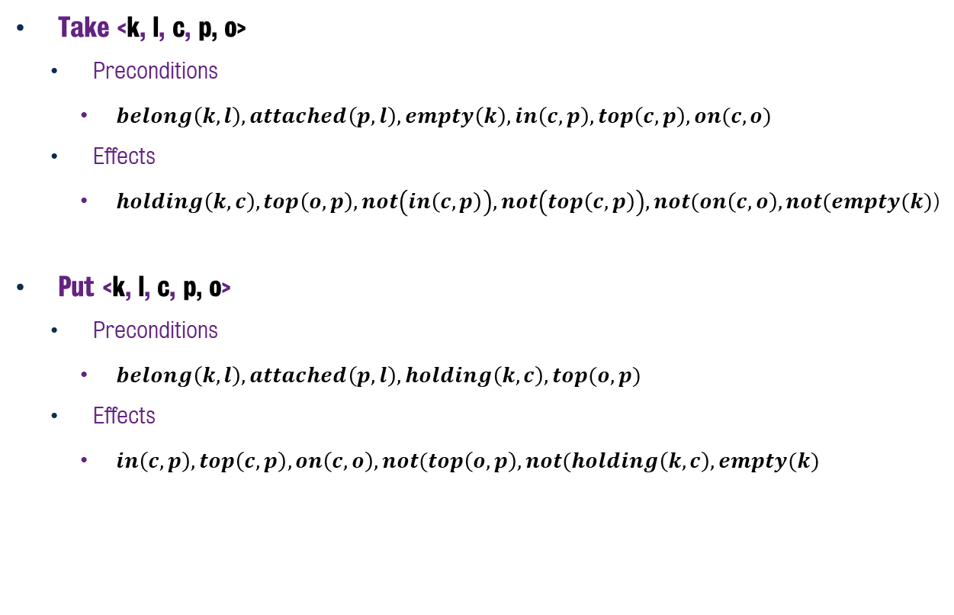
Dockworker: Actions
Take <k, l, c, p, o>
Preconditions
$belong\left(k,l\right), attached\left(p, l\right), empty\left(k\right), in\left(c,p\right), top\left(c,p\right), on(c,o)$
Effects
$holding\left(k, c\right), top\left(o, p\right), not\left(in\left(c,p\right)\right), not\left(top\left(c,p\right)\right), not(on\left(c,o\right), not(empty(k)$)
Put <k, l, c, p, o>
Preconditions
$belong\left(k,l\right),attached\left(p, l\right), holding\left(k,c\right), top(o,p)$
Effects
$in\left(c,p\right), top\left(c,p\right), on\left(c,o\right), not(top\left(o,p\right), not(holding\left(k,c\right), empty(k)$
Notes:
When we consider the actions we can execute, we have only two. Taking a container off of a pallet and putting it on another one.
This is all relatively straightforward, in that the both actions require the crane (denoted as k) and the pallets that the container is either being lifted from or put onto are related to the location. Hence the use of the belong and attached predicates.
The take action will then pick up a container and the crane will hold it. It will then also reassign the other container o as the top of that particular pile. Note that in this case, o can either be another container or the pallet itself, denoting that there are now no longer any containers atop that particular pallet.
Meanwhile, when we then attempt to put it down, in a manner similar to blocksworld and its ilk, we check whether the location is clear for us to put it where we intend to. All pretty straightforward and nothing we’ve never really seen before.
So if we were trying to solve this problem, we could in theory do this with a regular PDDL representation. We could move the containers around between locations and eventually reach the correct combination. However, there is a lot of bespoke information here about the nature of the problem that – if we knew about it in advance – would be really helpful. And this is where the HTN methods will come in handy, given they will permit us the ability to create compound tasks that allow us to deal with some of the specific issues we’re about to see here.

Slide 11
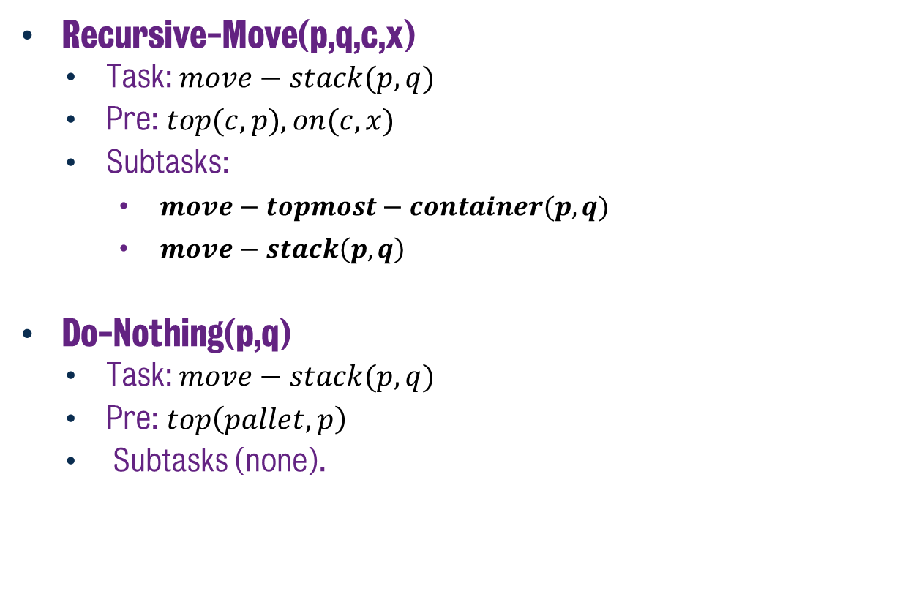
Dockworker: Methods
Recursive-Move(p,q,c,x)
Task: $move−stack(p,q)$
Pre: $top(c,p),on(c,x)$
Subtasks:
$move−topmost−container(p,q)$
$move−stack\left(p,q\right)$
Do-Nothing(p,q)
Task: $move−stack(p,q)$
Pre: $top\left(pallet,p\right)$
Subtasks (none).
Notes:
So we can start, by defining a method that explicitly solve the task of moving the stack of containers across from one pile to another. And the interesting part, is right here in the name – recursive move.
If we take a look at this method a little more closely, it has preconditions that state we cannot run this task lest we know that container c is at the top of pile p and we can figure out which container that c is atop of, so we can thet set that as top afterwards. Plus we can see that it not only is designed to solve the move-stack task, but it does so using two subtasks: first we move the topmost container from the original pile and onto another, but also, we have the move-stack task emerge as a subtask. This ensures that we continue to work our way down the stack by applying the same method again.
This task is recursive because it is asking us to solve the original task after it does everything else it needs to do. But in order for a recursive task like this to work, it also needs a base case. A situation where we can ensure that the recursion stops. To address this, there is the Do-Nothing task. This task checks whether only the pallet is at the top of a given pile, which means that the pile is empty. In the event that the pile is empty, we can apply this method which will effectively stop the recursive-move task from continuing to run, given we’ve completed moving every object.
But of course, we now have another task here, the move-topmost-container which will move items between each pile. So let’s take a look at that one.

Slide 12

Dockworker: Methods
Take-and-Put(c, k, l₁, l₂, p₁, p₂, x₁, x₂)
Task: $move−topmost−container(p1,p2)$
Pre: $top\left(c,p1\right), on\left(c,x\right), attached\left(p1,l1\right), belong\left(k,l1\right), attached\left(p2,l2\right), top(x2,p2)$
Subtasks:
$take(k,l,c,x1,p1)$
$put(k,l2,c,x2,p2)$
Notes:
So now we consider how the move-topmost-container task could be implemented. We have another method entitled take-and-put, which is rather self explanatory. In this instance, we are aiming to take the topmost item on a given pile and then move it to another one. The actual tasks are as expected, to execute both the take and put actions in that order. But what is interesting is that the preconditions of the method are essentially reinforcing that the grounding of variables for each task lines up in such a way that it is possible for these two actions to happen back to back. Hence we ensure that the two locations both use the same crane but also that we have the correct grounding of variables for each of these actions such that we don’t have to wait until the preconditions fail before realising that this isn’t valid.

Slide 13
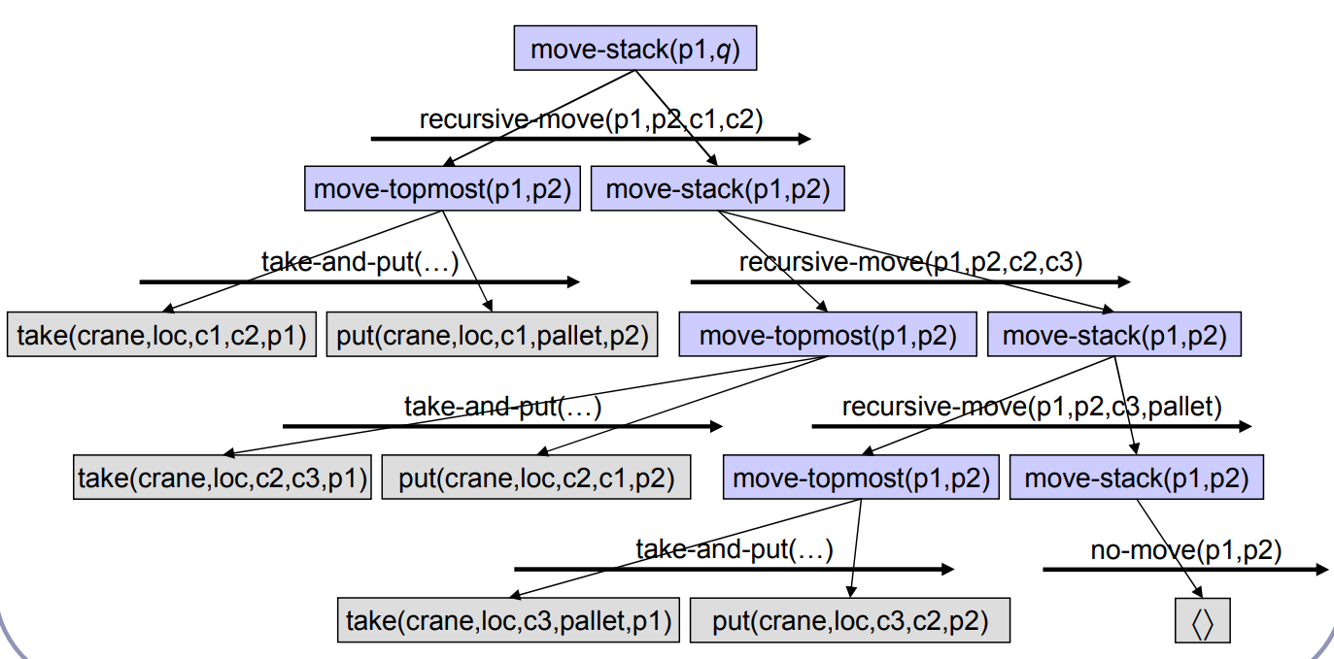
Dockworker Example
Notes:
And so if we consider how this will roll out, we can see that moving one stack from p1 to another location, will roll out in this fashion.
In this example, we’re moving a collection of three containers from one location to another. And this is how that would roll out for that one particular pile.
But this still doesn’t solve the problem, given we can now move one pile of containers from one position to another, but when we do so, the ordering is now upside down. So how do we resolve this?

Slide 14

Dockworker: Methods
Move-Stack-Twice(p₁, p₂, p₃)
Task: $move−stack\left(p1,p3\right)$
Pre: $None$
Subtasks:
$move−stack(p1,p2)$
$move−stack(p2,p3)$
Notes:
The solution, is to create another method that can solve the move-stack problem. In this case, we create a task that actually moves a stack twice, by running the move stack task twice but on a collection of three parameters. Our main locations we wish to move between and an intermediate. So if we were to consider the three pallets in location 1, p1a p2b and p1c, we would list them in this order, given we can then move the collection into an upside down configuration in the intermediary location, followed by then moving it back into the correct orientation in the final location.
So in essence, we can then solve the moving of one stack from a given location to another using the one task, which will then be decomposed into the recursive task, generating the take and put actions in the correct sequence.

Slide 15

Dockworker: Methods
Move-Each-Twice()
Task: $move−all−stacks()$
Pre: $None$
Subtasks:
$move−stack(p1a,p1b)$
$move−stack(p1b,p1c)$
$move−stack(p2a,p2b)$
$move−stack(p2b,p2c)$
$move−stack(p3a,p3b)$
$move−stack(p3b,p3c)$
Notes:
And in fact we can then roll this out one step further, by actually solving the entire problem using one method, which is to then call all of these other methods.
This is naturally a rather trivial example and not intended to give us a complicated problem to solve. But in essence using these methods for compound tasks, we can then solve the entire problem rather easily.

Slide 16
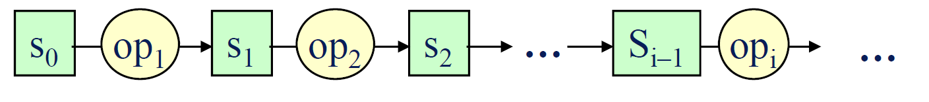
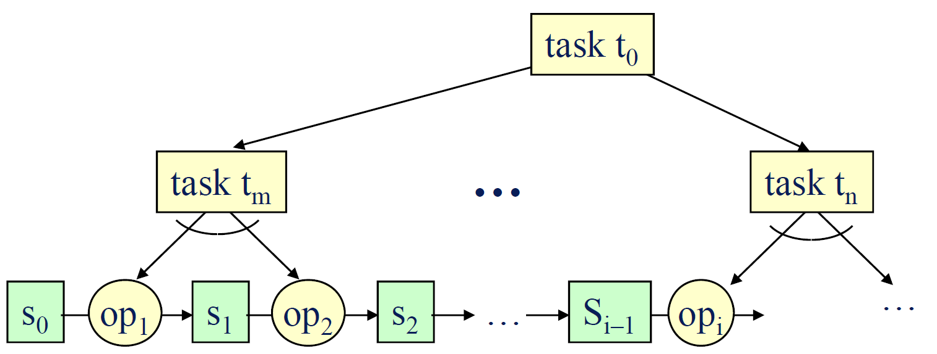
Searching in HTN
Unlike state-space planning, where you either search forward or backward, we have the option of searching in two directions in HTN:
Backward/Forward
Selecting tasks
Up/Down
Processing tasks into sub-tasks or action.
Image Credit: Lecture Slides for Automated Planning and Acting
Nau, D. 2016
Notes:
So if we consider how the HTN planning process works, it’s a process of selecting tasks and then configuring them with the correct parameters. Hence we’re moving across the search space to generate tasks, and then downwards as we explore the valid permutations of those tasks. This is very much in contrast to regular search where we either search forwards into the state space and find valid state action pairings or backwards from the goal to reach the initial state.
It’s a different approach where given we already have the tasks available to us, the process is less about finding states that get us closer to the goal, but instead finding valid permutations of the tasks grounded with respected to the current state facts such that it will provide a valid path through the state space to the goal. Which in this case, is simply satisfying the original problem states that we’re provided with.

Slide 17
Searching in HTN
Important to ensure that when attempt to process a task, we know what the world state would be at this point.
Hence in this instance, it’s important that when a task is broken into subtasks, they’re processed in order such that the world state is already planned in advance.
Notes:
So when we actually reach a given task, it’s important that we know what the current state is prior to any attempt to roll it out.
If we look at this example here, where tasks t₀ is rolled out into two more tasks t_{m} and t_{n} it’s critical that before we attempt to enumerate task t_{n} that we have rolled out t_{m} before it. Given in this case, if there was only two tasks, then the outcome of task t_{m} is going to be used to check the preconditions of t_{n} as well as the actions that it translates into.
Hence this actually exposes one of the issues that exists with this approach, in that it is reliant on total ordering of tasks such that it can rely on the state model.

Slide 18
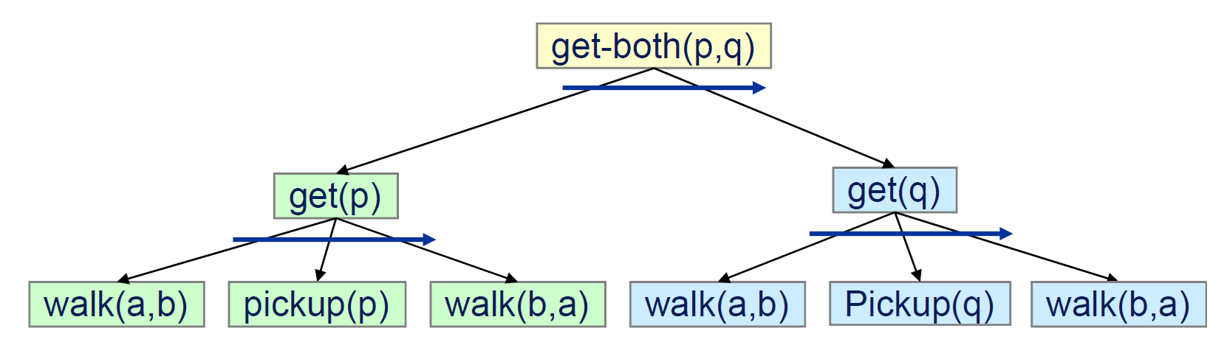
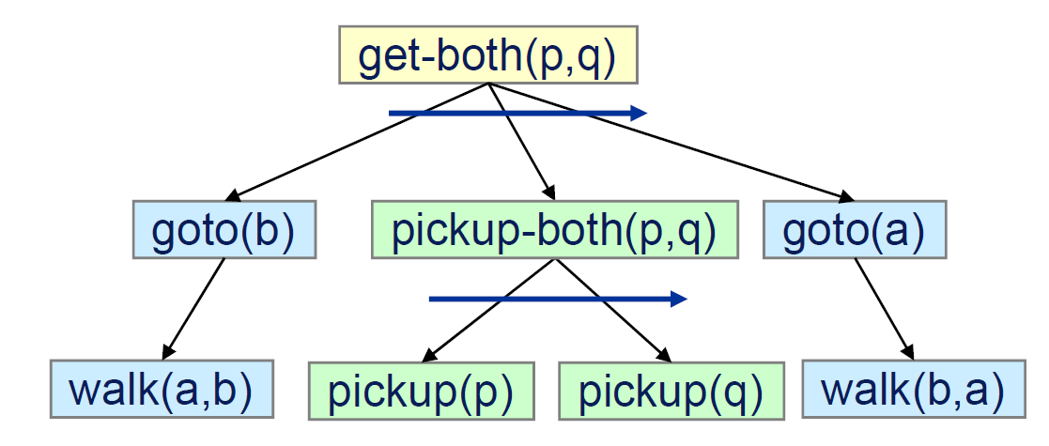
Total vs Partial Ordering
The simplest approach (STN planning) is reliant on ordering constraints.
Forward search required given need to test for applicability of the state.
Interweaving actions need to be written into a more concise formalism.
That said, partial ordering is feasible, but requires a more complex algorithm to achieve it.
Notes:
Ultimately this approach as described works well given that it is reliant on the ordering constraints of actions applied to the state before it can then check subsequent tasks. As a result, moving into any sort of partial ordering is difficult, given we cannot write tasks such that they interleave subtasks and then rely on the planner to figure out the final ordering.
So for example, this original task called get both, which essentially walks to a location, picks up and object and walks back, cannot be built to run the exist get task twice, or rather it can, but the original approach for STN planning will not consider the idea that these two tasks can be interwoven. Hence it will walk from a to b, pick up p, walk back and then do it all again. Instead as a designer, we have to go in and design the task such that it walks only once, picks up both items and then walks both.
However, it is possible to have partial ordering, but the process of how the algorithm works is more complicated and beyond the scope of what we want to cover here. That said, if you’re interested, we will provide additional material on KEATS for you to explore.

Slide 19
STN vs HTN Planning
HTN planning is a more general implementation of STN.
Variety of formalisms and algorithms that are employed.
Forward Search – SHOP2
Plan-space Planning – O-Plan
Constraints can be associated with tasks and methods.
i.e. What facts are true at the before, during and after a task/method is executed.
Use of goals/subgoals instead of tasks/subtasks.
GDP/GoDeL
Notes:
As we wrap up, we’ve largely discussed STN planning – it being a subset of HTN planning – and it’s already a more expressive formulism than classical planning.
In fact, any classical planning problem can be translated into an ordered STN problem in polynomial time. But more interestingly, some STN planning problems cannot be expressed in traditional classical planning.
But as we wrap up, given this session is kinda falsely advertised, given we focussed more on STN planning than HTN, let’s take a moment to quickly discuss what HTN planning actually is and what we’ve missed out on.
The big difference really is that HTN is a generalisation of the principles we have discussed here today, with no real formal definition, it’s really a family of different approaches that utilise these basic principles.
The most vanilla of these is the SHOP2 planner, which is essentially a standard forward search planner that implements this process, albeit with partially ordered tasks. Whereas O-Plan injects more constraints int o the planning process, ensuring essentially temporal planning style constraints on the rollout of subtasks as they occur.
So yes, it was slightly false advertising, but the core principles of all of these planners is more or less consistent with what we covered in this session.

Slide 20
Classical Planning
Non-Forward Search
Introduction to HTN Planning
6CCS3AIP – Artificial Intelligence Planning
Dr Tommy Thompson
Notes:
And with that, we’ll wrap up this session introducing HTN Planning. Thanks for watching and keep an eye on KEATS for additional material and discussion surrounding this topic!

